Slide 1
SMS SPAM DETECTION USING NLP
An NLP Approach with Python and Scikit-learn
22D01A6656-D. Suprathika
22D01A6657-D. Poorna
22D01A6658-D. Karna
22D01A6659-D. Mahabob Pasha

Slide 2

The Problem
What is SMS Spam? Unsolicited, unwanted commercial messages sent to mobile phones.
Why is it a problem? It can be annoying, lead to phishing scams, spread malware, and cause financial loss.
Our Goal: To create an automated system that can accurately classify a
text message as either "Spam" (unwanted) or "Ham" (legitimate).

Slide 3
Our Approach & Tools 🛠️
Methodology: We will use Natural Language Processing (NLP) to understand the text and a Supervised Machine Learning model to classify it.
Key Python Libraries:
pandas: For loading and managing our dataset.
scikit-learn: For building and evaluating the machine learning model.
joblib: For saving our trained model for future use.

Slide 4
The Dataset 📊
Dataset: cleaned_messages2.csv
Key Columns:
cleaned_message: This column contains the text of the SMS messages, which has already been pre-processed (e.g., lowercase, punctuation removed).
label: This is our target. It tells us if the message is 'spam' or 'ham'.
Data Preparation:
We load the data using pandas.
We drop any rows that have missing message text to ensure data quality.

Slide 5
Data Splitting
Why Split the Data? We need to test our model on data it has never seen before to know if it actually learned.
The Strategy: We split our dataset into two parts:
Training Set (80%): Used to teach the model the patterns of spam and ham.
Testing Set (20%): Used to evaluate the model's performance on unseen data.
Code: train_test_split(X, y, test_size=0.2, random_state=42, stratify=y)
stratify=y is important! It ensures that both the training and testing sets have the same proportion of spam and ham messages as the original dataset.

Slide 6
Text to Numbers (Vectorization)
The Challenge: Machine learning models only understand numbers, not words.
The Solution: TF-IDF (Term Frequency-Inverse Document Frequency)
This technique converts text into a numerical matrix.
It gives a higher score to words that are important to a specific message but not common across all messages. For example, the word "free" or "congratulations" might get a high TF-IDF score in spam messages.
Implementation: We use TfidfVectorizer from scikit-learn.
fit_transform() on the training data to learn the vocabulary and create vectors.
transform() on the testing data to convert it using the same learned vocabulary.

Slide 7
Training the Model
Algorithm Choice: Multinomial Naive Bayes
This is a classic probabilistic algorithm based on Bayes' Theorem.
It's highly effective and computationally efficient for text classification problems like this one.
It works by calculating the probability that a message belongs to a certain class (spam or ham) given the words it contains.
The Training Process:
We feed the vectorized training text (X_train_vec) and the corresponding labels (y_train) to the model.
Code: model.fit(X_train_vec, y_train)

Slide 8
Evaluating Performance
How good is our model? We make predictions on the unseen test data and compare them to the actual labels.
Key Metrics (from the classification_report):
  Accuracy: What percentage of messages did we classify correctly overall?
  Precision: Of all the messages we predicted as spam, how many were actually spam? (High precision means few false positives).
  Recall: Of all the messages that were actually spam, how many did we catch? (High recall means few false negatives).
  F1-Score: A balanced average of Precision and Recall. This is often the most important metric for an unbalanced dataset.

Slide 9
Saving the Model for the Future
Why Save? We don't want to retrain the model from scratch every time we need to classify a new message.
What We Save:
The Model (spam_detection_model.joblib): The trained Naive Bayes classifier that knows the patterns.
The Vectorizer (tfidf_vectorizer.joblib): This is critical. We need it to transform any new incoming message in the exact same way as the training data before feeding it to the model.
Implementation: We use joblib.dump() to save both objects to files.

Slide 10
Conclusion & Next Steps
Summary: We successfully built an NLP model that can classify SMS messages as spam or ham by using TF-IDF vectorization and a Multinomial Naive Bayes classifier.
Future Improvements:
Experiment with other algorithms (e.g., Logistic Regression, Support Vector Machines).
Use more advanced techniques like word embeddings (Word2Vec, GloVe).
Deploy the model as part of a web application or mobile app.

Slide 11
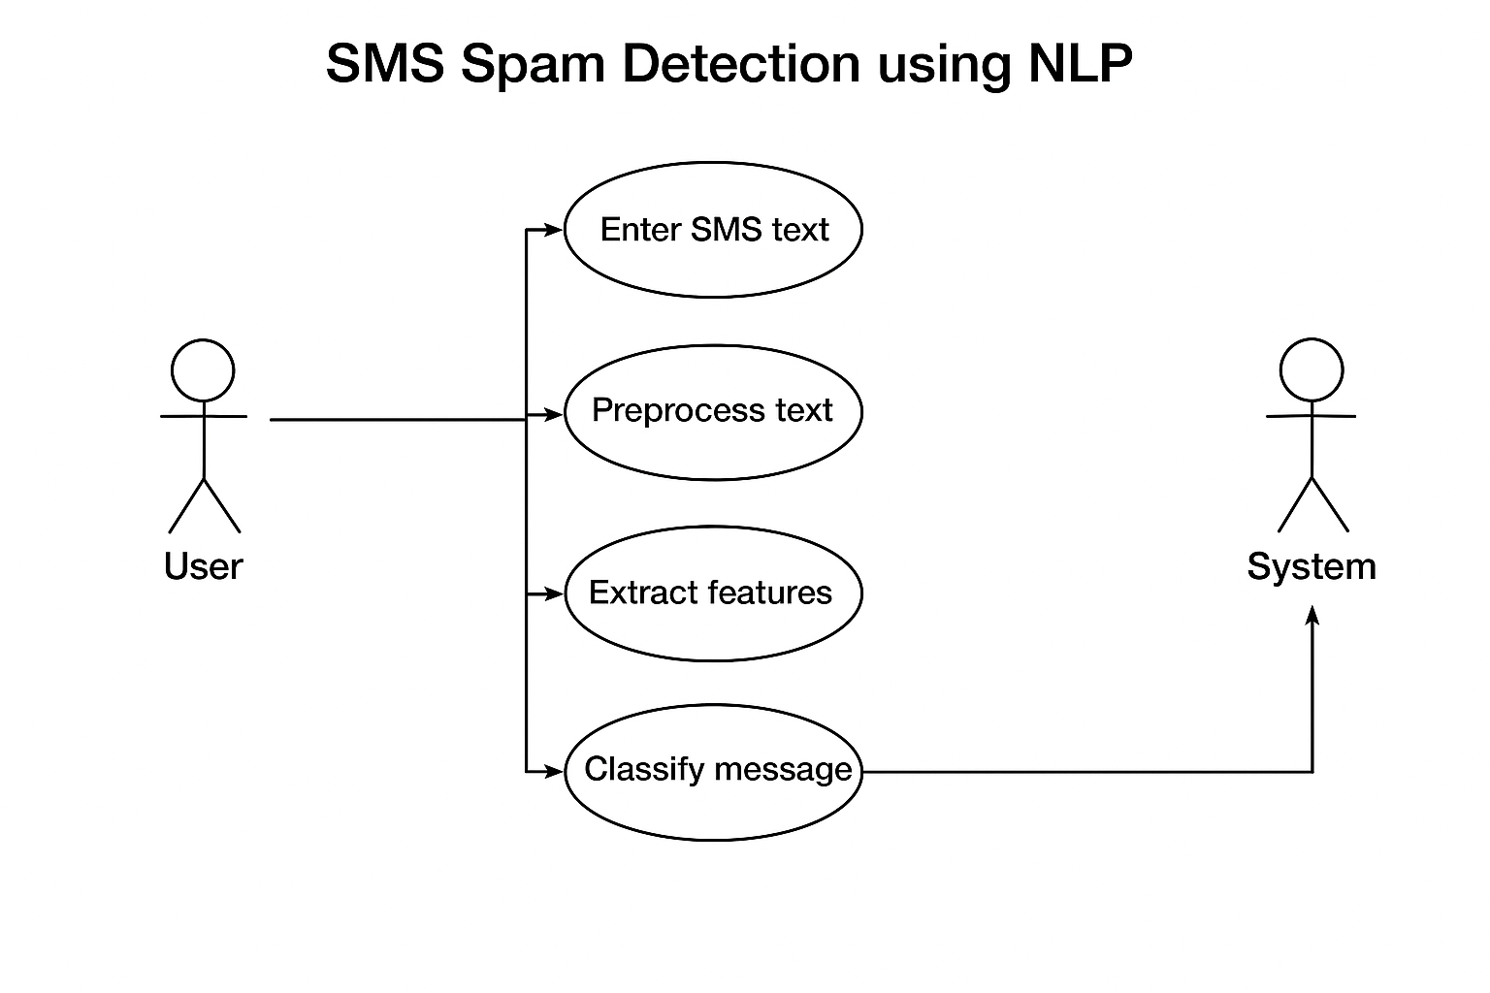
UML Diagrams

Slide 12
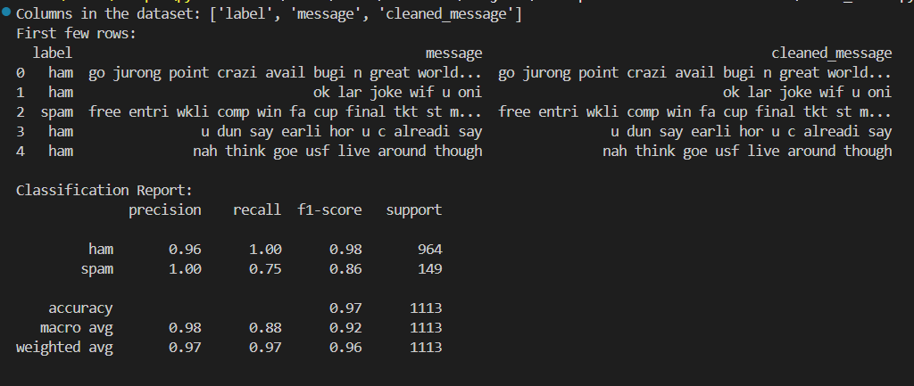

Slide 13
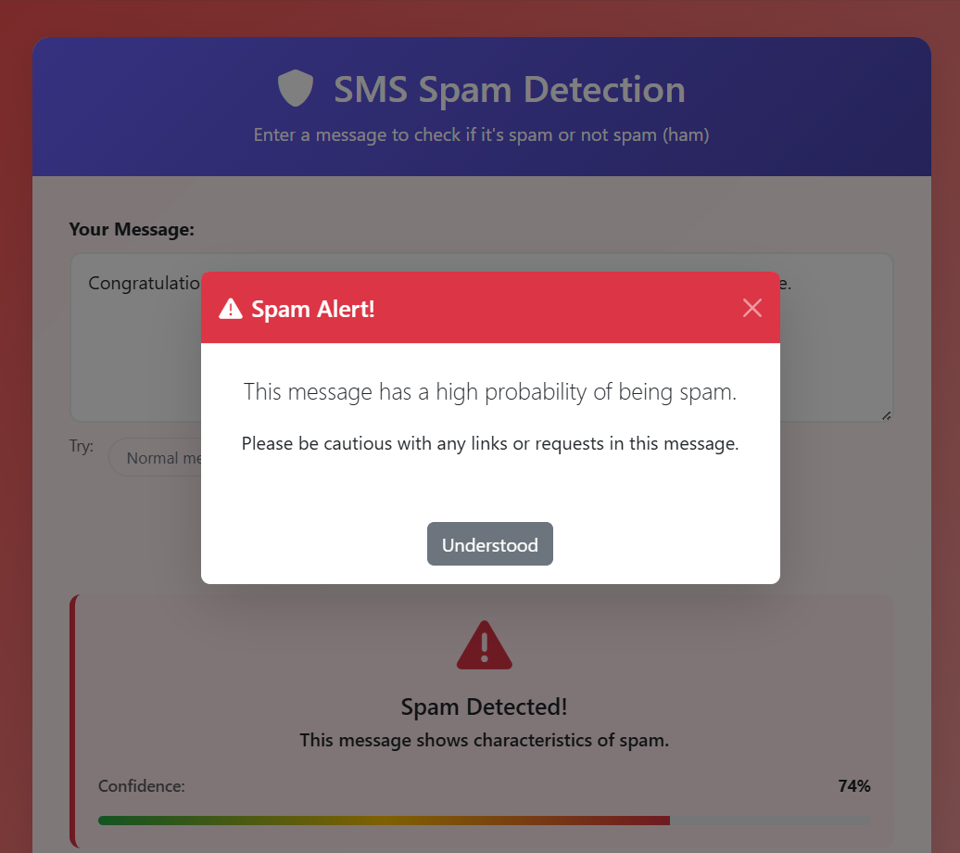
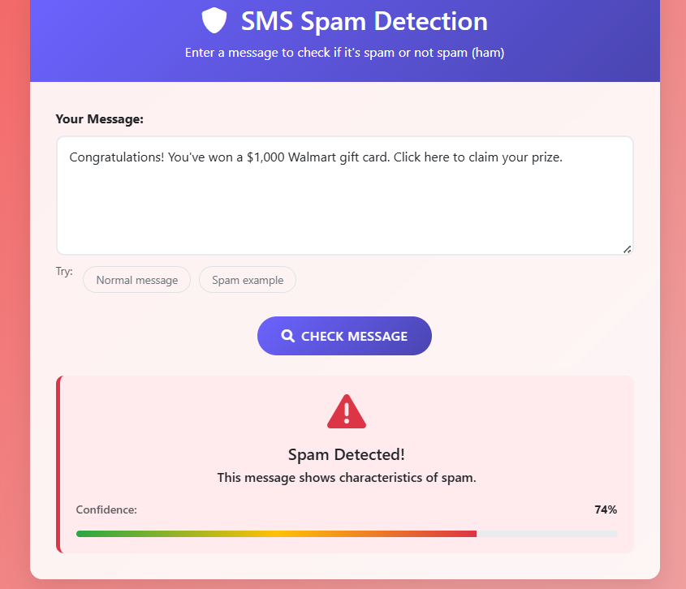
Output Screens - Spam Messages

Slide 14
